Slide 1
State Government
K. Stafford
2013 MBMS

Slide 2
Federalism
A system of government in which power is divided and shared between national , state and local government

Slide 3
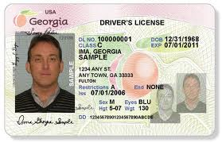
Article IV
Article IV Section 1- Must respect legal actions by another state
Example- Drivers License
Article IV Section 2 –Must treat people from another state equal to those of the state
Example- Can’t punish people from a different state harsher then those from the home state.

Slide 4
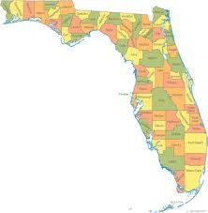
Article IV
Article IV Section 3- Guarantees each states area
Example- Land may not be taken from a state to form a new state without that states permission, No two states shall join to make 1 state unless they agree
Article IV Section 4-Each state shall have a republican form of government
Example- Governors, State Legislatures, State Supreme Courts

Slide 5
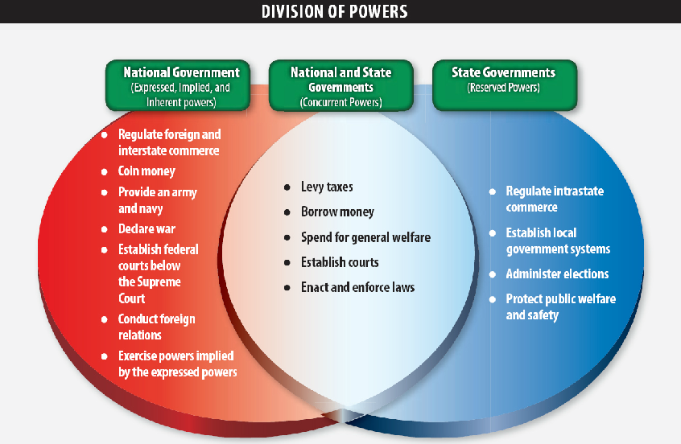

Slide 6
Supremacy Clause
The Constitution limits the states powers through Article VI and the Supremacy Clause
Supremacy Clause-The clause that states that the U.S. Constitution is the supreme law of the land, and that national laws are supreme over state laws, found in Article VI

Slide 7
US vs Florida
U.S. Constitution | Florida Constitution
1st Constitution of Nation | 6th Constitution of Florida
7 Articles | 12 Articles
Bill of Rights adds first 10 Amendments | Begins with Declaration of Rights
Broad Governmental Framework | Specific items such as State Lottery, Conservation, Transportation and Smoking at the Work Place
Establish State Government | Establish Local Government
Says nothing about Public Education | Establishes Public Education
Allows for Amendments | Requires Review for Amendments every 20 years

Slide 8
Weird Florida Laws
Doors of all public buildings must open outwards.
You are not allowed to break more than three dishes per day, or chip the edges of more than four cups and/or saucers.
A special law prohibits unmarried women from parachuting on Sunday or she shall risk arrest, fine, and/or jailing.

